Slide 1


Multimedia Image Processing App Robert John Nagi 220900021

Slide 2
WHAT THE PROGRAM DOES
Converting images from RGB to many color modes, including negative (CMY), grayscale, binary, HSV, and LAB.
Applying rotation, translation, and resizing.
Applying different effects, including quantization, dithering, and median cut.
Displaying RGB and grayscale histogram.
Compression of images, with different techniques, including DCT, DWT, Haar DWT, and Wavedec.

Slide 3
LOAD IMAGE

Slide 4
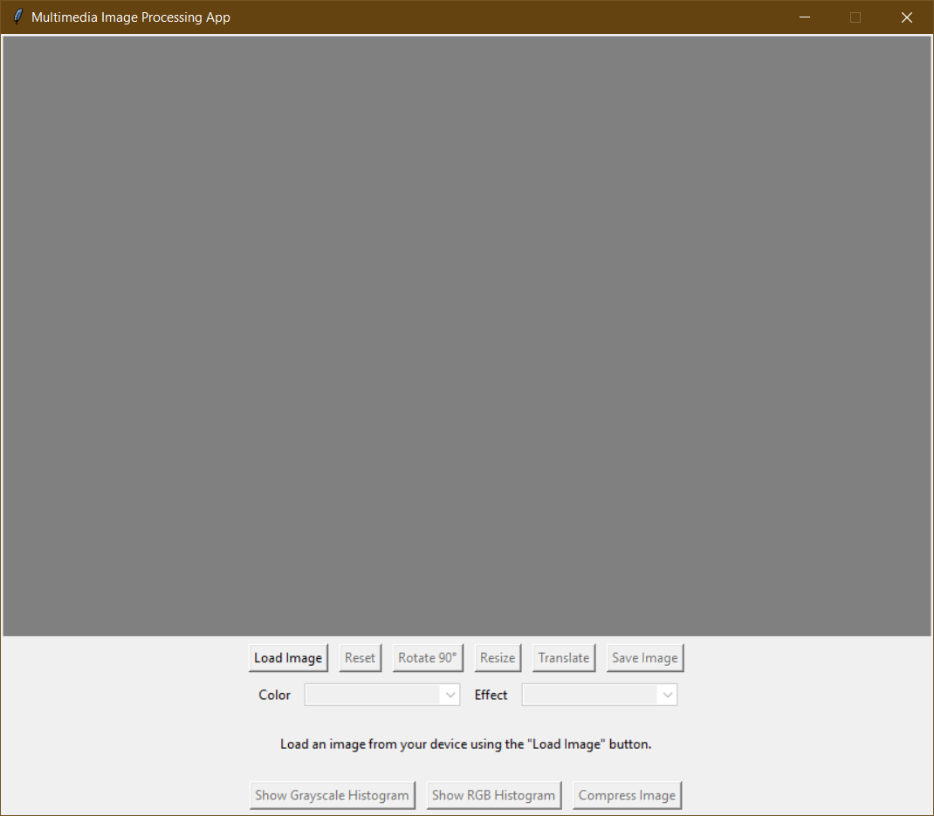
LOAD AN IMAGE
To load an image, click the “Load Image” button, and choose an image from your computer.
If an image is chosen, it will be displayed in the canvas.
Canvas

Slide 5
ROTATE, RESIZE & TRANSLATE

Slide 6
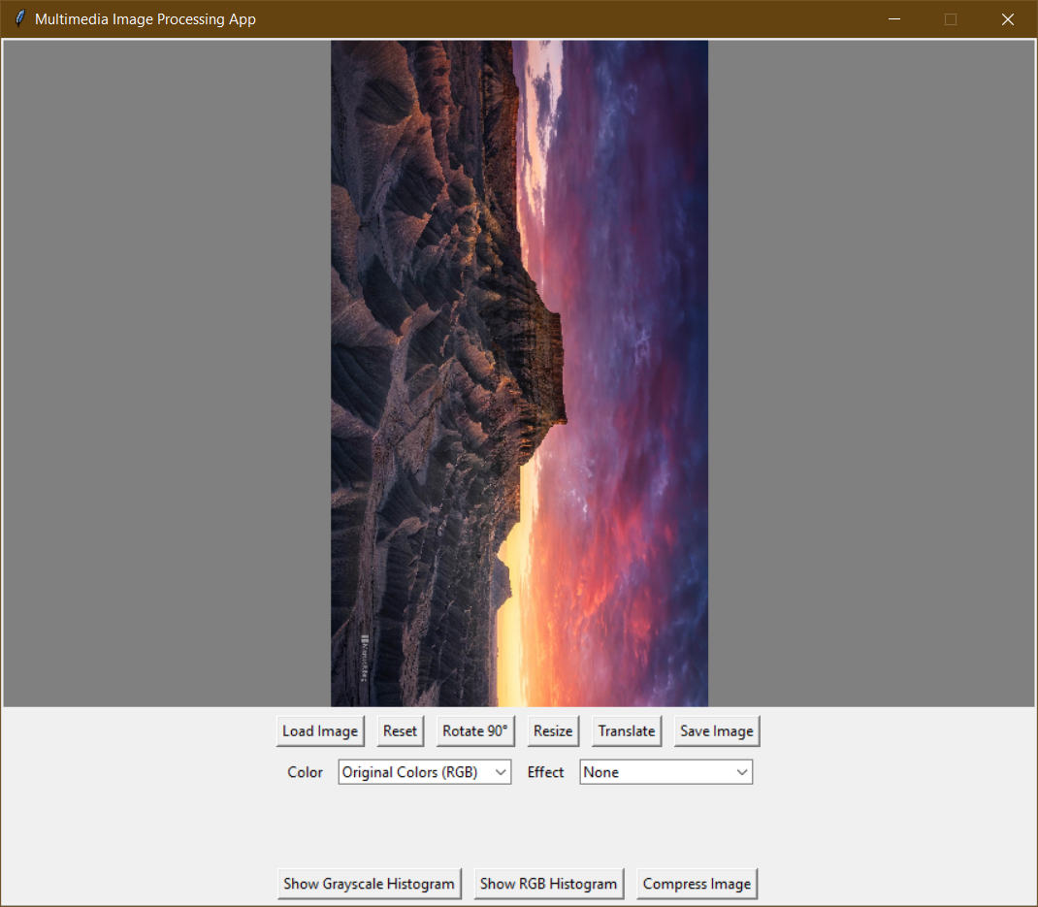
ROTATE IMAGE
The “Rotate 90°”button rotates the image ninety degrees clockwise.

Slide 7
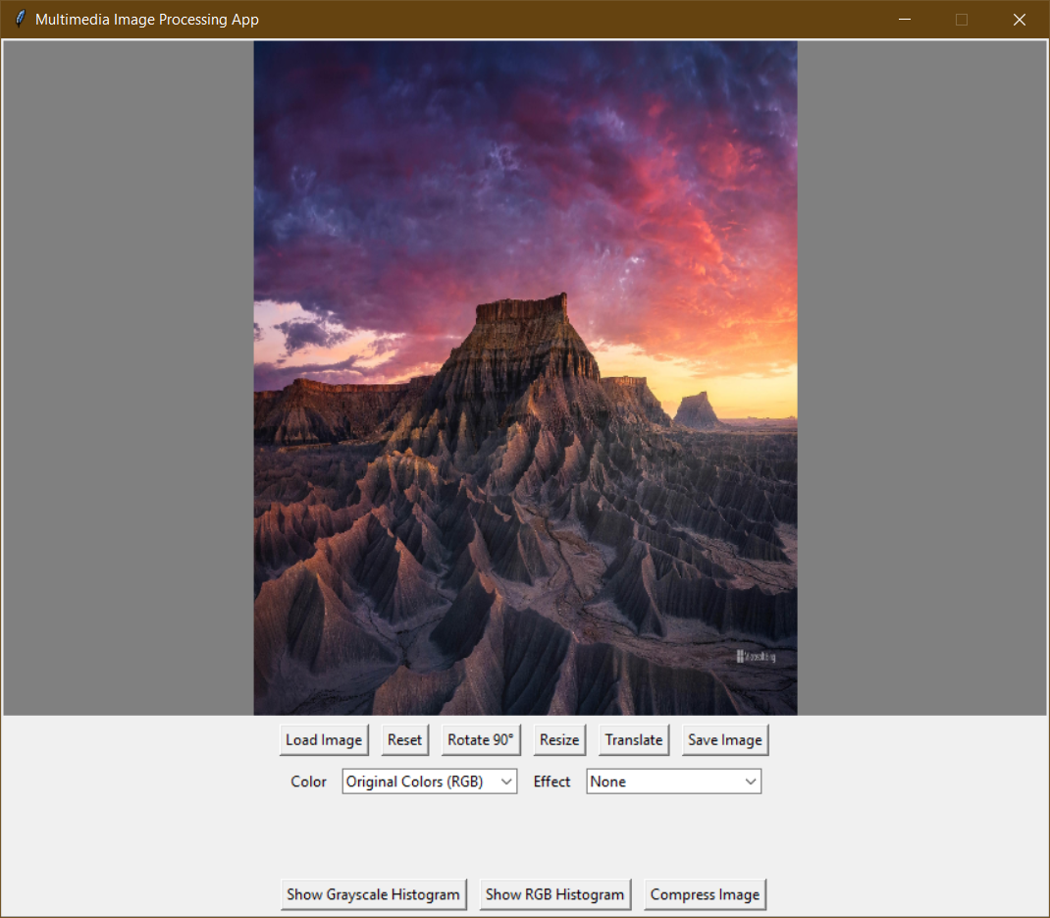
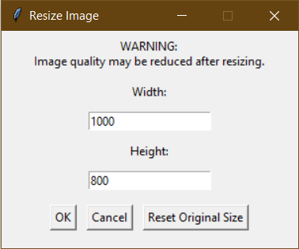
RESIZE IMAGE
The “Resize” button opens a small window for resizing options.

Slide 8
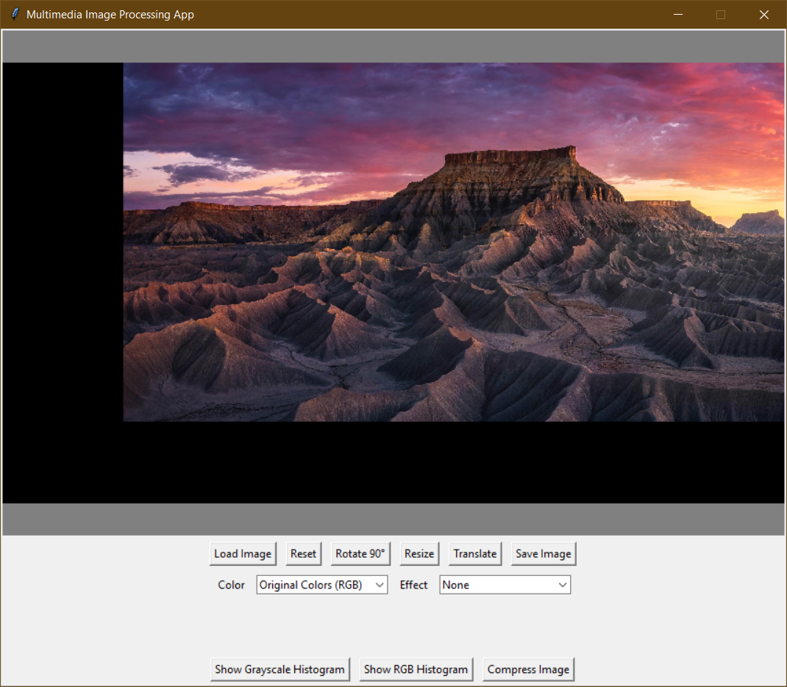
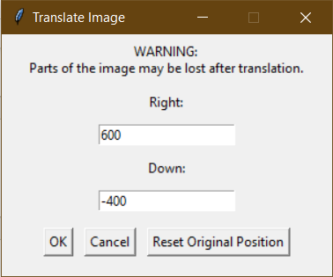
TRANSLATE IMAGE
The “Translate” button opens a small window for translation options.

Slide 9
COLOR MODELS

Slide 10
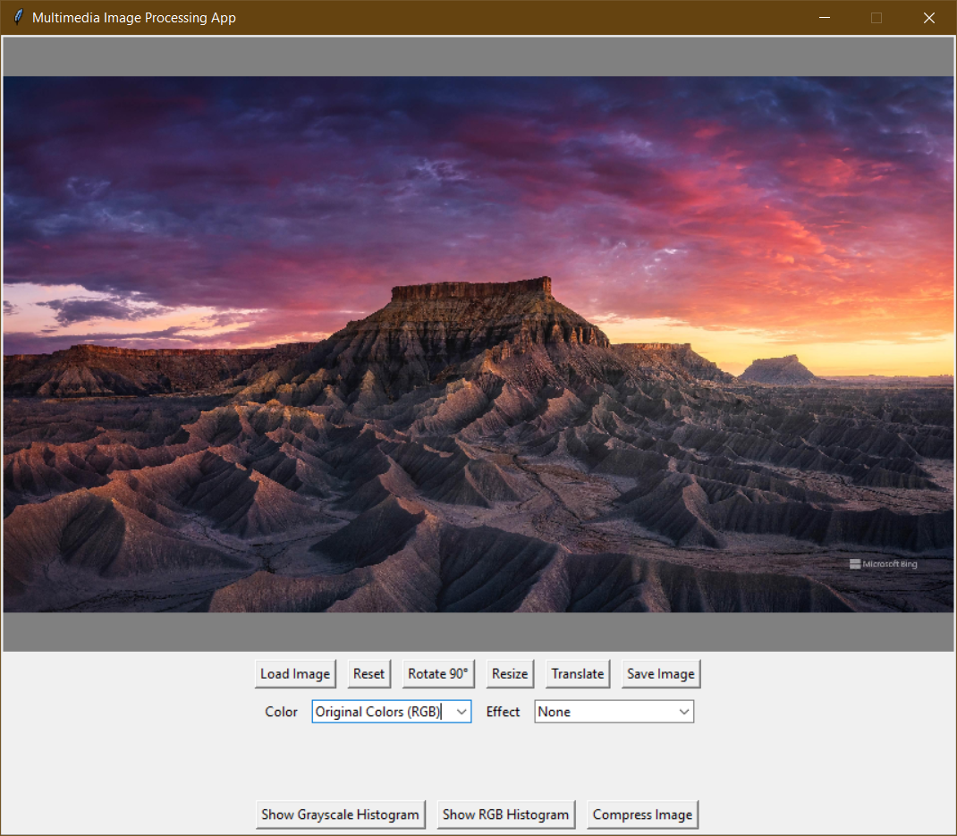
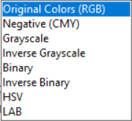
COLOR MODELS - RGB
The image can be viewed in different color models:
Original Colors (RGB)
Negative Colors (CMY)
Grayscale
Inverse Grayscale
Binary
Inverse Binary
HSV
LAB
The default color model is Red, Green, Blue (RGB).

Slide 11
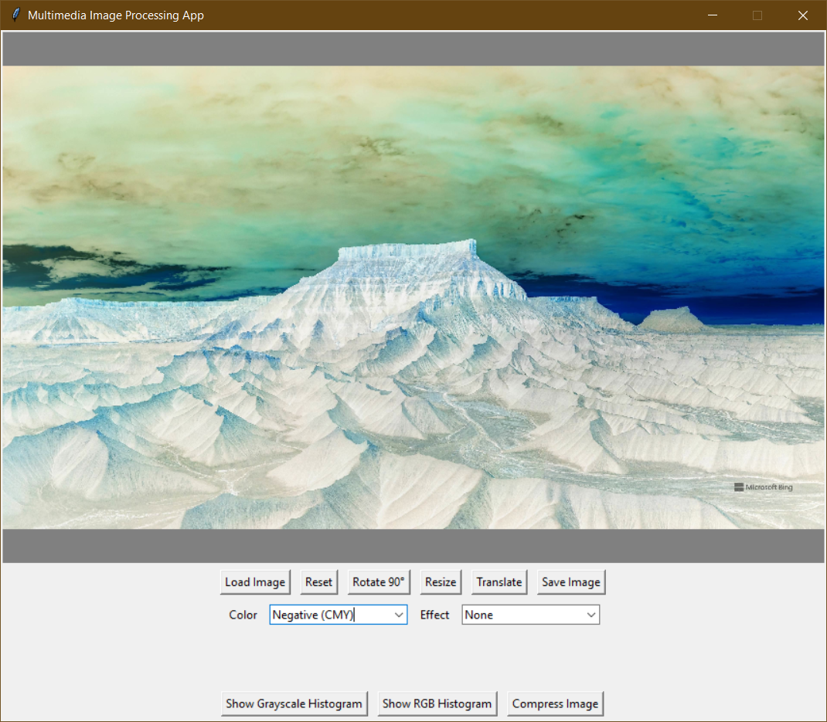
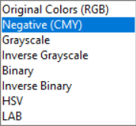
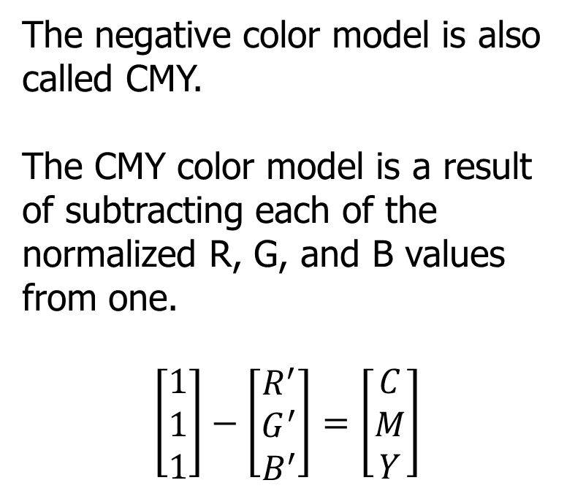
COLOR MODELS – NEGATIVE (CMY)
The negative color model is also called CMY.
The CMY color model is a result of subtracting each of the normalized R, G, and B values from one.
$$\left[\begin{matrix}1 \\ 1 \\ 1\end{matrix}\right]−\left[\begin{matrix}R^{′} \\ G^{′} \\ B^{′}\end{matrix}\right]=\left[\begin{matrix}C \\ M \\ Y\end{matrix}\right]$$

Slide 12
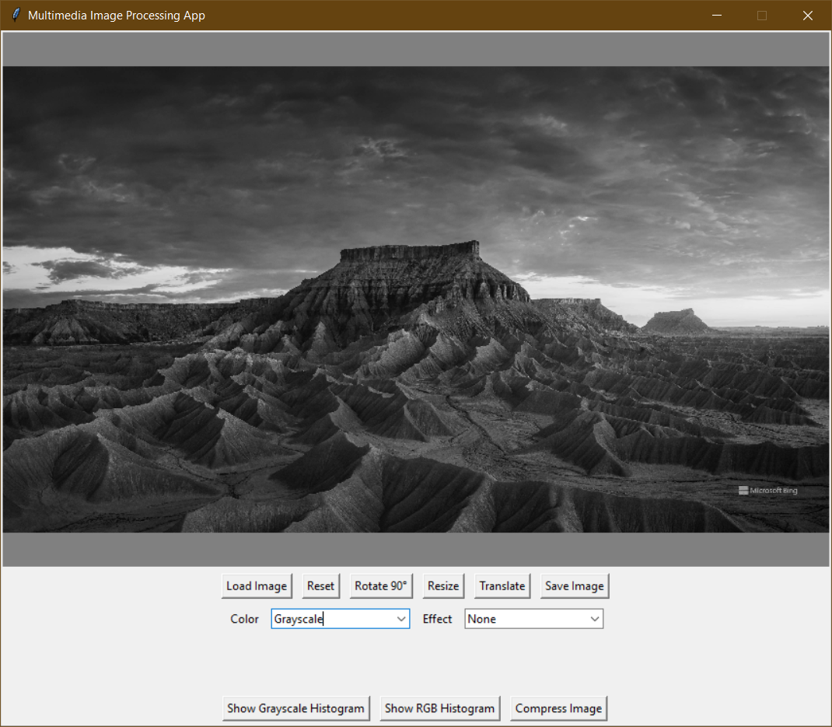
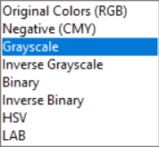
COLOR MODELS – GRAYSCALE
The grayscale image is an image that has only has gray level colors.
It has 256 gray levels, starting from 0 (black) to 255 (white).

Slide 13
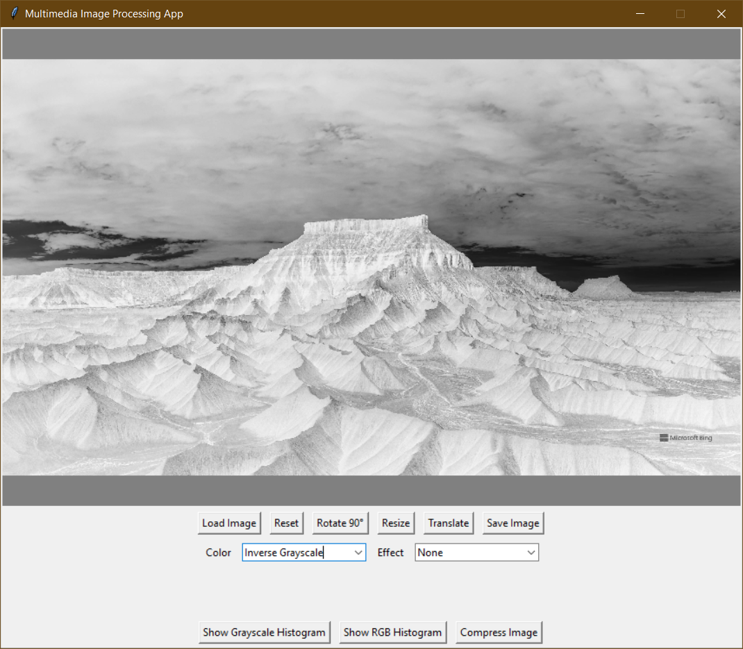
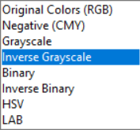
COLOR MODELS – INVERSE GRAYSCALE
The inverse grayscale is simply swapping the subtracting the pixel intensity value from 255.
Black becomes white, and white becomes black.
It’s like applying negative filter to a grayscale image.

Slide 14
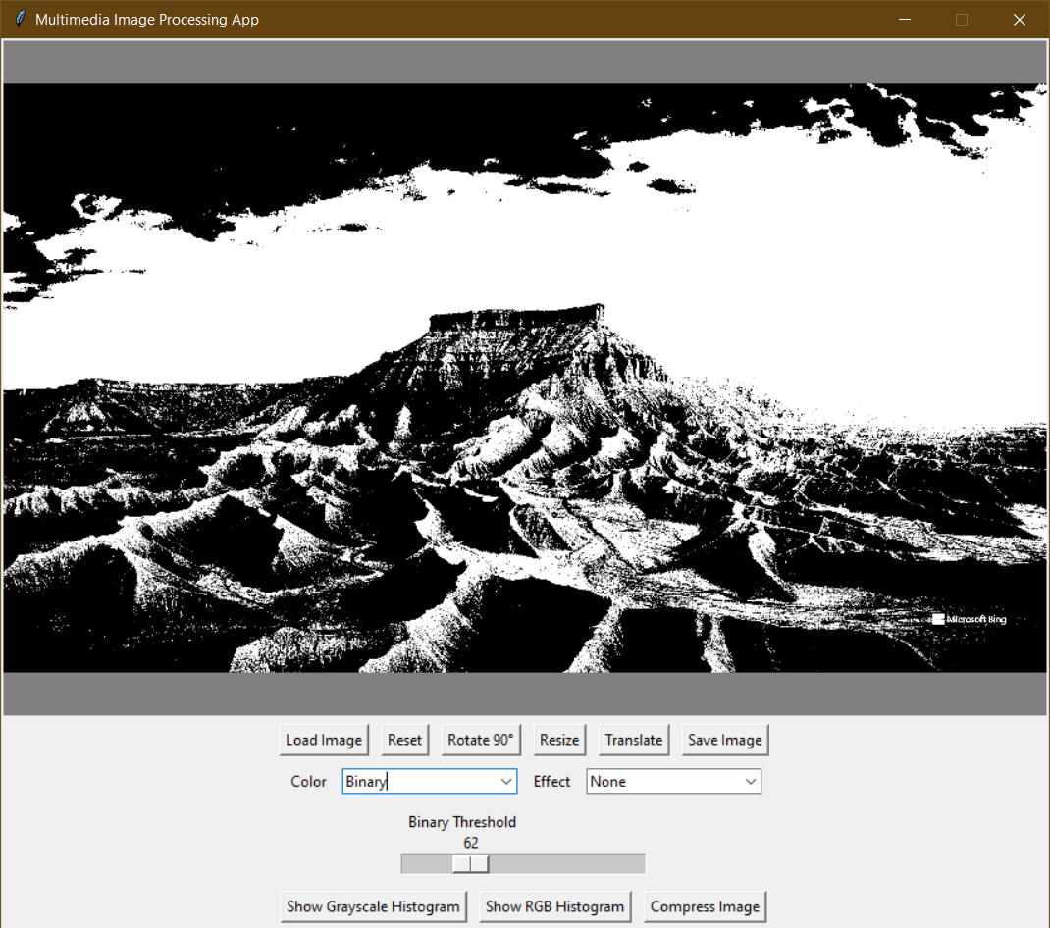
COLOR MODELS – BINARY
The binary image is an image that only contains two values for each pixel: 0 (black) and 1 (white).
Image is automatically converted to grayscale before thresholding.
The indicated slider controls the threshold value.
Pixel Value < Threshold ? → Black
Pixel Value ≥ Threshold ? → White

Slide 15
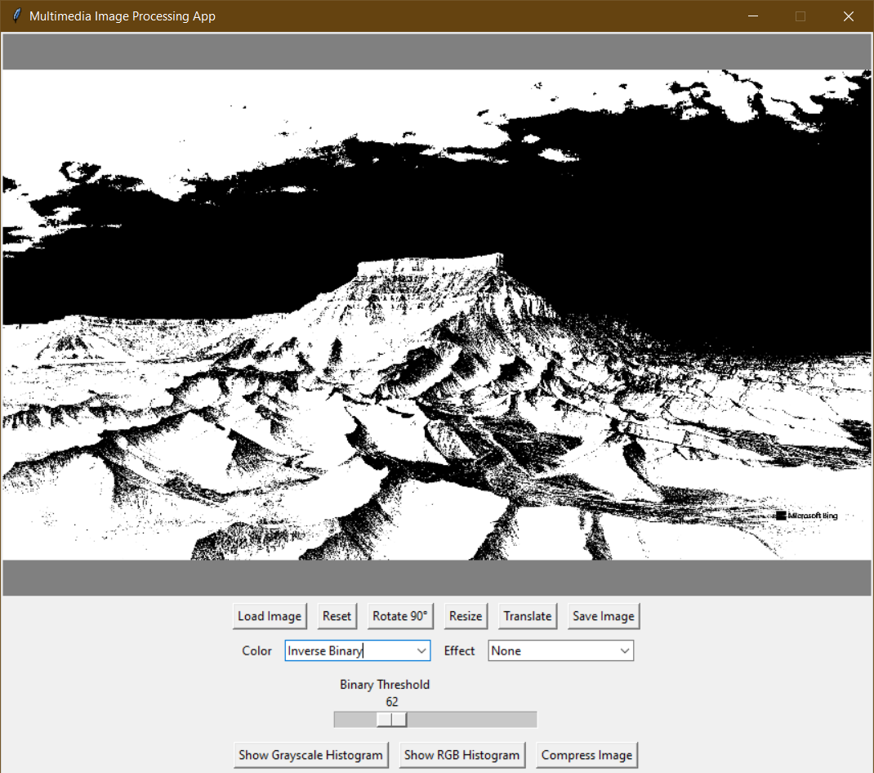
COLOR MODELS – INVERSE BINARY
Similar to inverse grayscale.
Pixel Value < Threshold ? → White
Pixel Value ≥ Threshold ? → Black

Slide 16
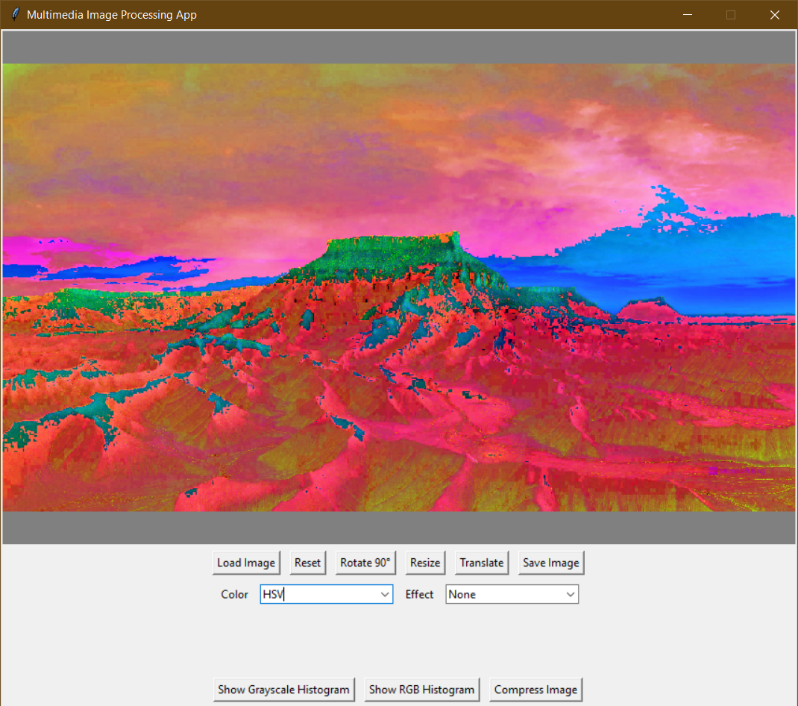
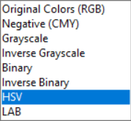
COLOR MODELS – HSV
The HSV color model represents hue, saturation, and value/intensity.
Useful for tasks like color filtering, segmentation, and object detection.

Slide 17
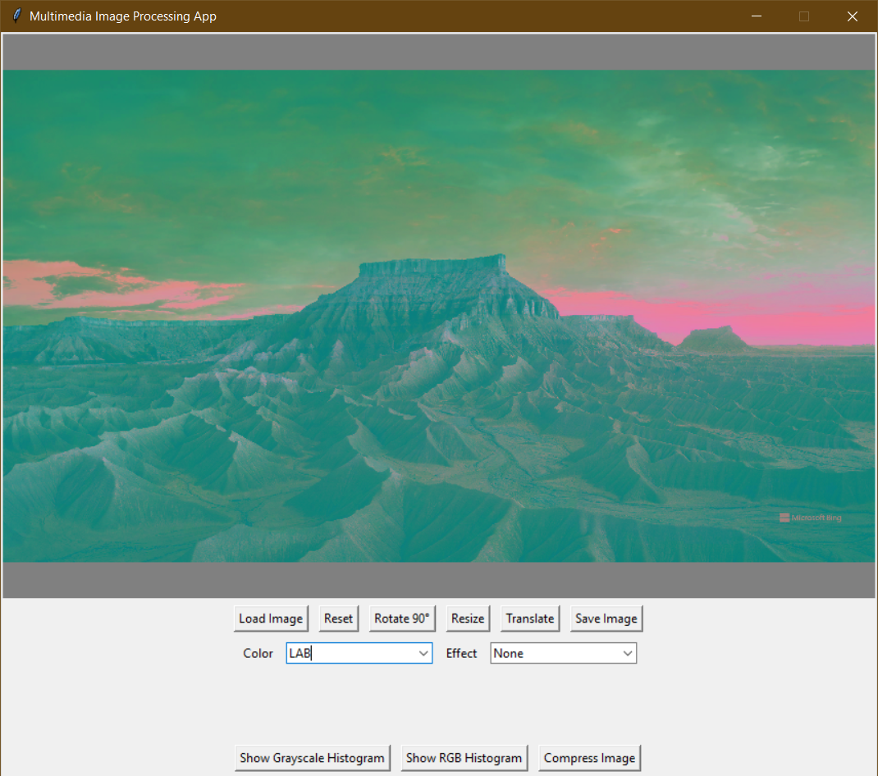
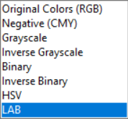
COLOR MODELS – LAB
The LAB color model represents lightness/luminance, green-red opponent color axis, and blue-yellow opponent color axis.
Used in advanced image editing software for precise color adjustments and corrections.

Slide 18
Effects

Slide 19
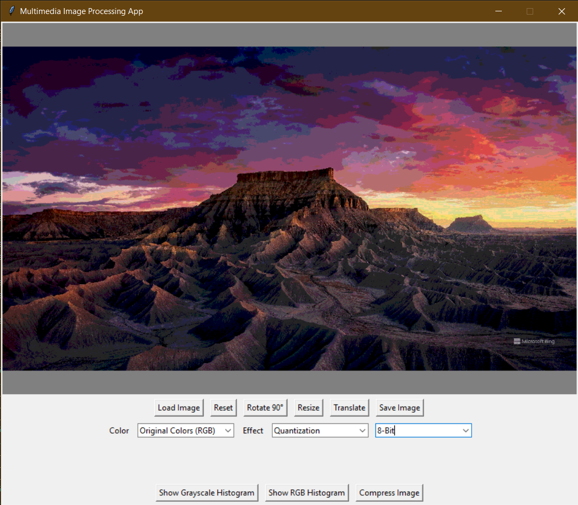
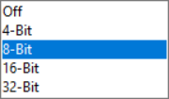
QUANTIZATION
Image quantization is a technique used to reduce the number of colors or gray levels in an image.
In this program, there you reduce the number of bits per pixel to 4, 8, 16, or 32 bits.
Can be applied on both color and grayscale images.

Slide 20
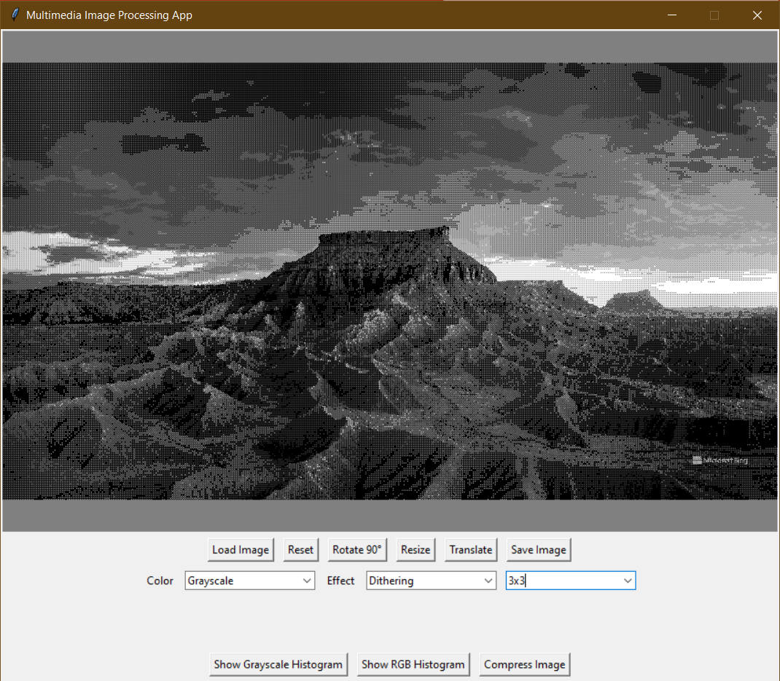
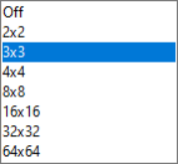
DITHERING
It is used to create an illusion of more color when displaying an image that has low color
depth.
In this program, the dithering matrix size can be 2x2, 3x3, 4x4, 8x8, and more…
Only applied on grayscale images.
Cannot be applied on other color models.

Slide 21
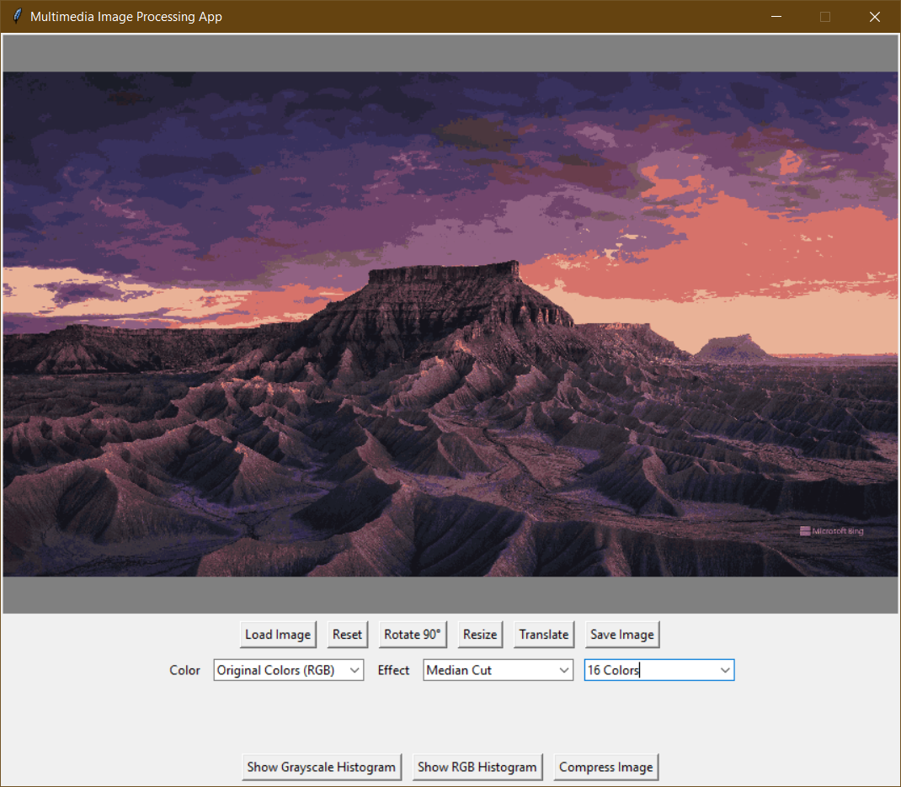
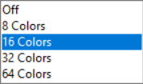
MEDIAN CUT
It’s an adaptive algorithm for color quantization to select the best representative subset of colors. Used for discretizing a continuous color space.
In this program, you can choose to discretize to 8, 16, 32, 64 colors.
Cannot be applied on grayscale or binary images.
Only applied on color images.

Slide 22
Histogram

Slide 23

HISTOGRAM
The histogram visualizes the frequency of each pixel intensity value.
There’s a histogram for gray levels and a histogram for RGB levels.
They can be viewed by clicking the indicated buttons.

Slide 24
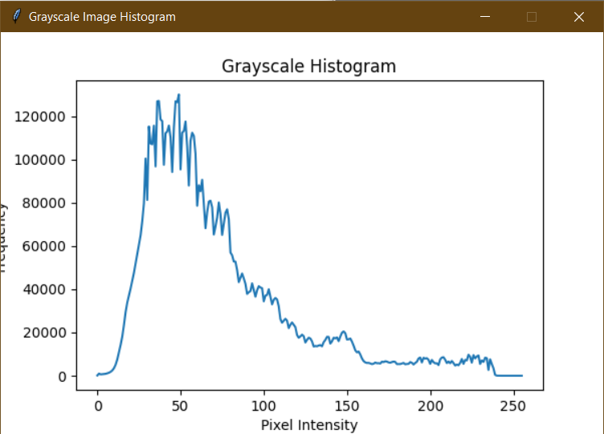
HISTOGRAM - GRAYSCALE
The grayscale histogram visualizes the frequency of each pixel’s gray level intensity value.

Slide 25
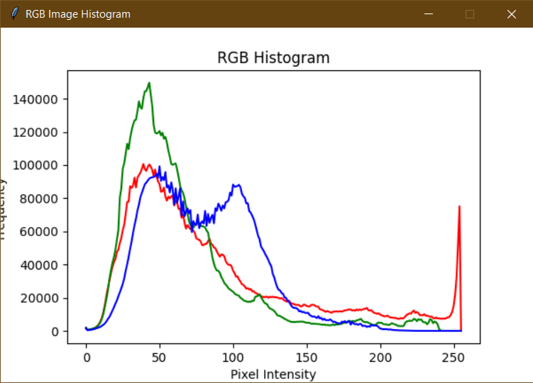
HISTOGRAM - RGB
The RGB histogram visualizes the frequency of each intensity value in each of the red, green, and blue colors in the image.

Slide 26
Compression

Slide 27
COMPRESSION
Compression is used to reduce the image’s storage space; by reducing the number of bits the image can consume from the memory.
Compression has multiple techniques:
DCT
DWT
Haar DWT
Wavedec
Click the indicated button to apply compression.

Slide 28
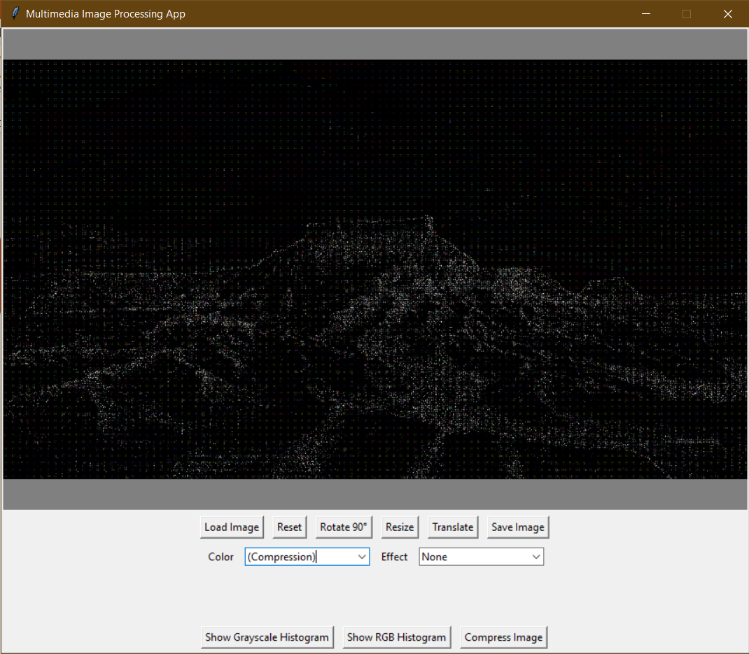
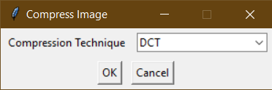
COMPRESSION - DCT
Discrete Cosine Transform (DCT) can be applied on color or grayscale images.

Slide 29
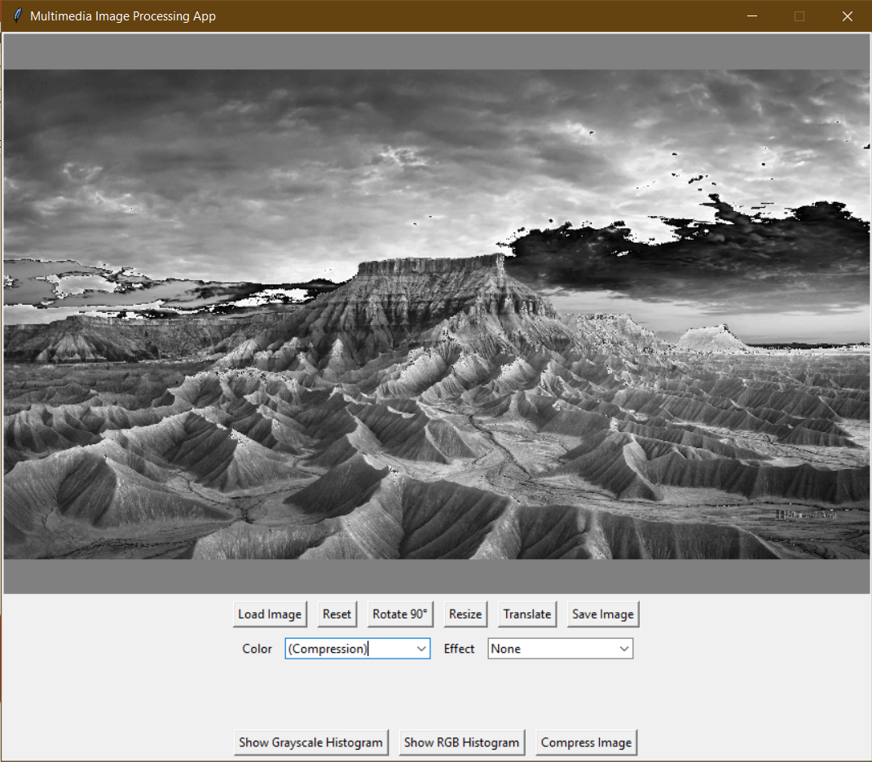
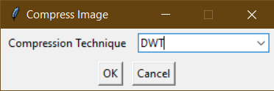
COMPRESSION - DWT
Discrete Wavelet Transform (DWT) can be only applied on grayscale images.

Slide 30

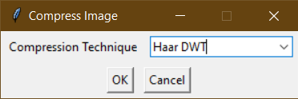
COMPRESSION – HAAR DWT
There’s no noticeable difference between DWT and Haar 1D DWT
Haar 1D Discrete Wavelet Transform (DWT) is also applied on grayscale images only.

Slide 31
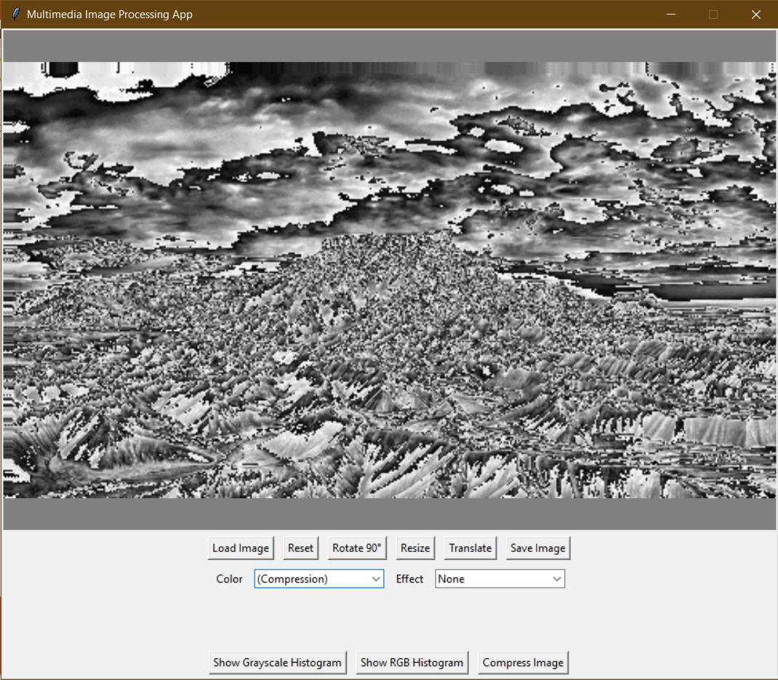
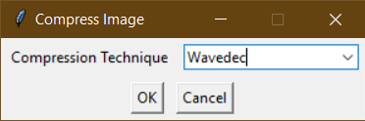
COMPRESSION – WAVEDEC
Wavedec is also applied on grayscale images only.

Slide 32
Reset & Save

Slide 33
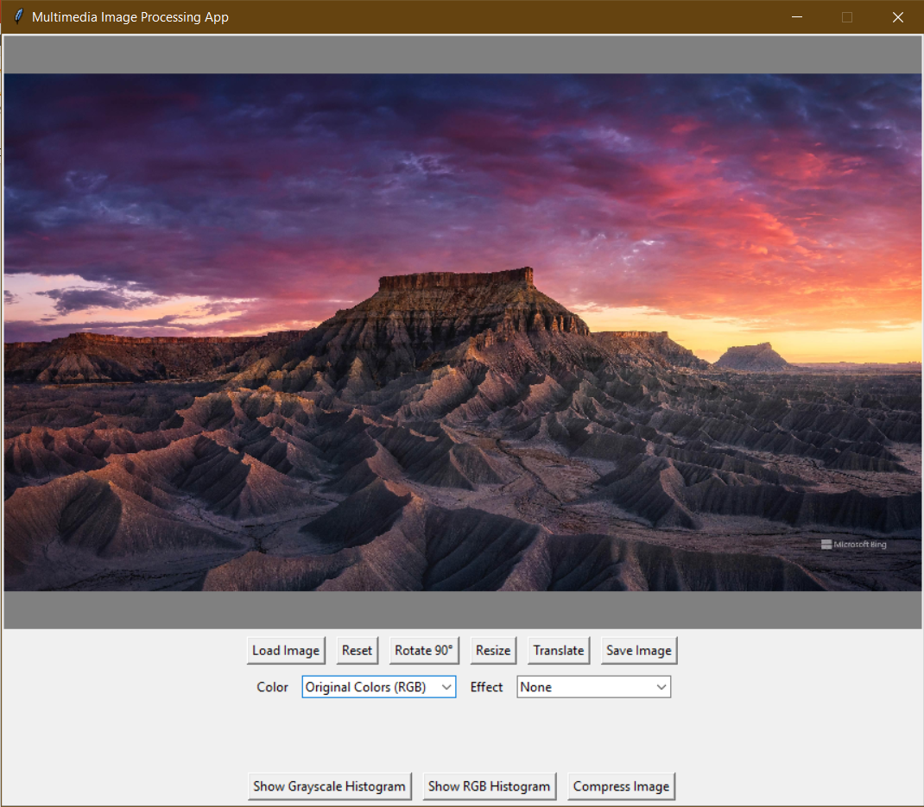
RESET IMAGE
The “Reset” button restores the original state of the image.
Reverts the image to how it looked like when it was loaded in the beginning.

Slide 34
SAVE IMAGE
Finished processing the image and want to save your work?
Click the “Save Image” button to save your processed image on your computer’s storage.

Slide 35

Thank you

